Slide 1
Etch-a-Sketch on SH1106 OLED
Microcontroller-based graphics system
Samuel Dinerman
ECE 3411 – Microprocessor Applications Laboratory
04/04/26
Notes:
This project implements an interactive Etch A Sketch using an SH1106 OLED display and analog inputs, focusing on low-level display control and embedded graphics.

Slide 2
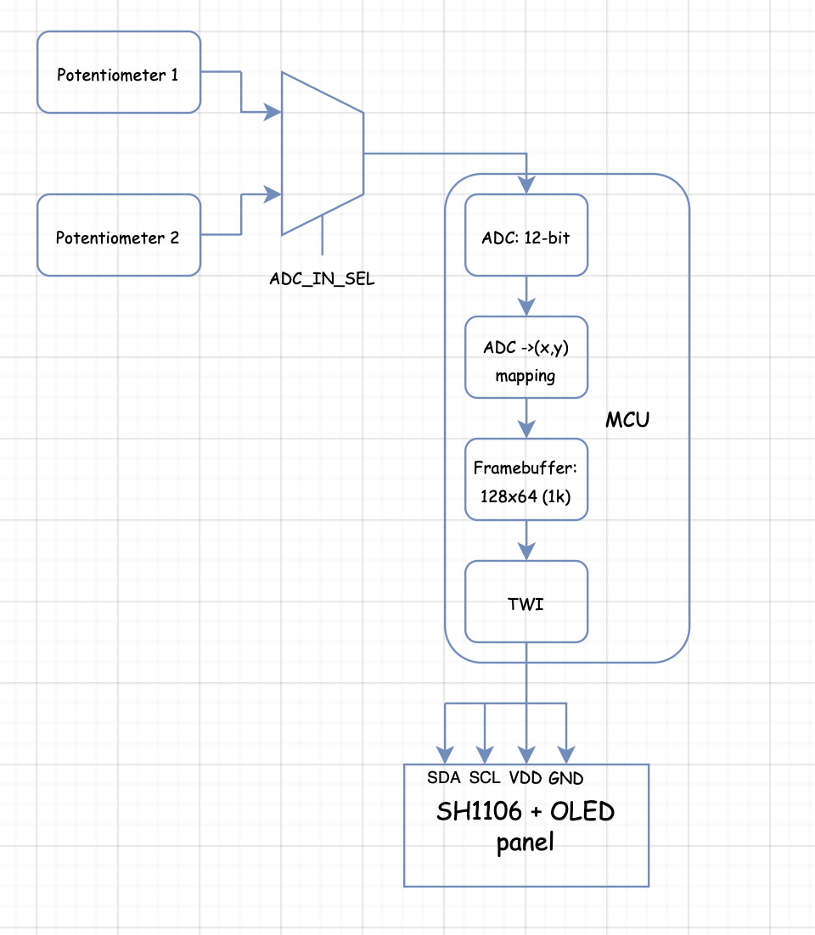
System Overview
The system uses a single ADC, so inputs are multiplexed and sampled sequentially.
The digital values are mapped to screen coordinates, stored in a frame buffer, and transmitted over TWI to the SH1106 controller.

Slide 3
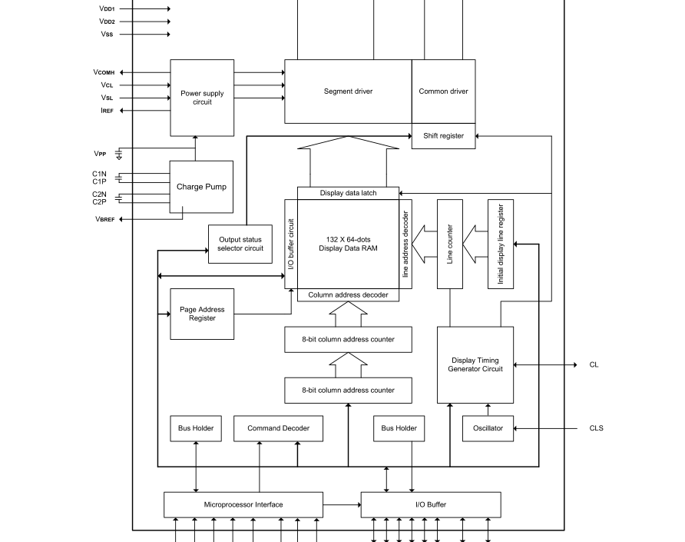
Display Architecture
The display stores pixel data in internal RAM, and driver circuits scan rows and columns to generate the image.

Slide 4
I2C Writing summary
To write commands to the SH1106 over I2C, the master begins with a START condition and transmits the 7-bit slave address with the write bit. After the display acknowledges the address, the master sends a control byte of 0x00, which selects command mode. The subsequent byte stream is then interpreted as command bytes, with each transmitted byte acknowledged by the slave. The command stream continues until the master issues a STOP condition.

Slide 5
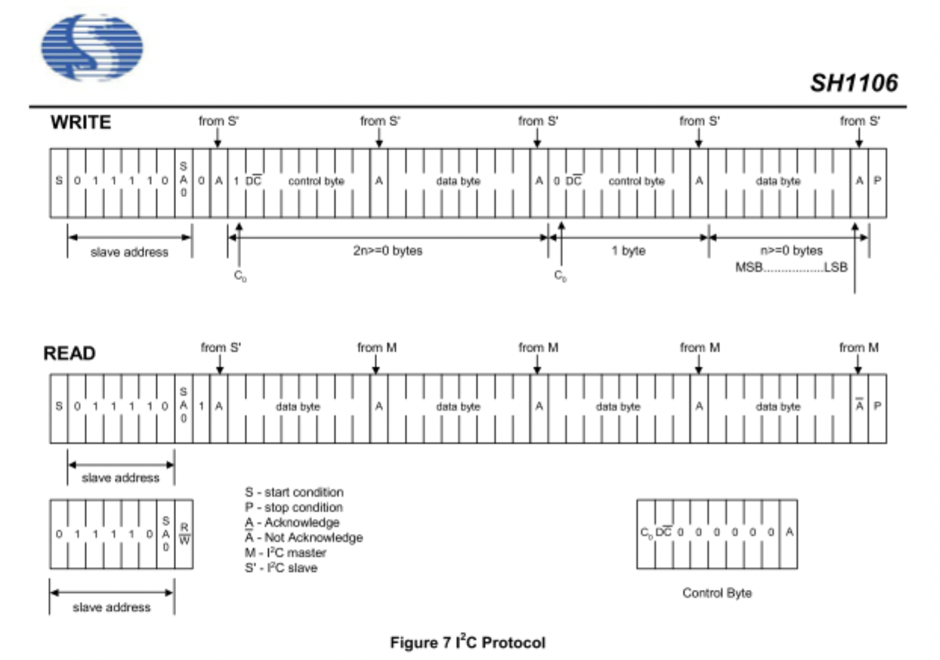

Slide 6
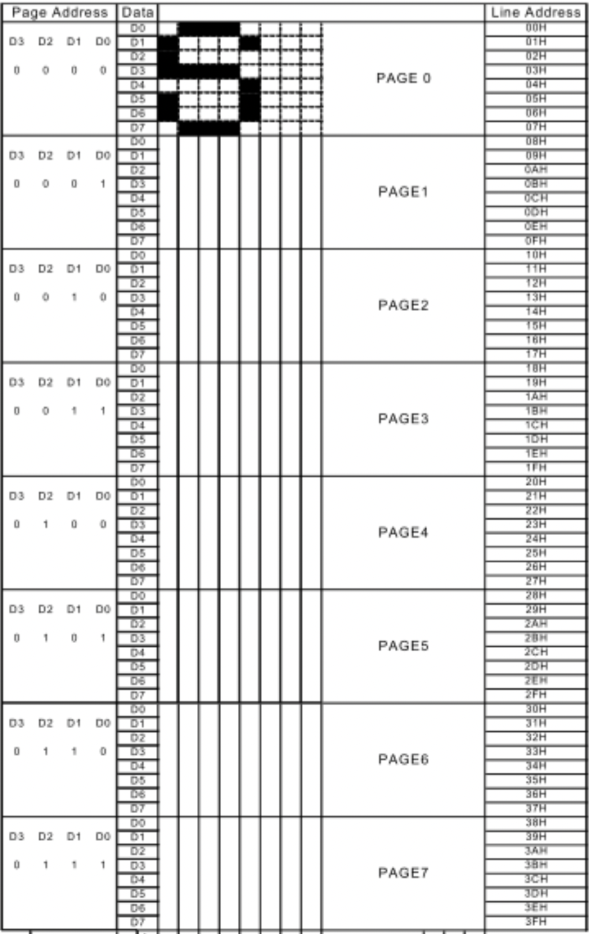
Display Addressing
The display is divided into 8 pages, each 8 pixels tall
Each column stores 1 byte representing 8 vertical pixels
Writing a byte fills a vertical column within the selected page
The column address auto-increments after each write

Slide 7
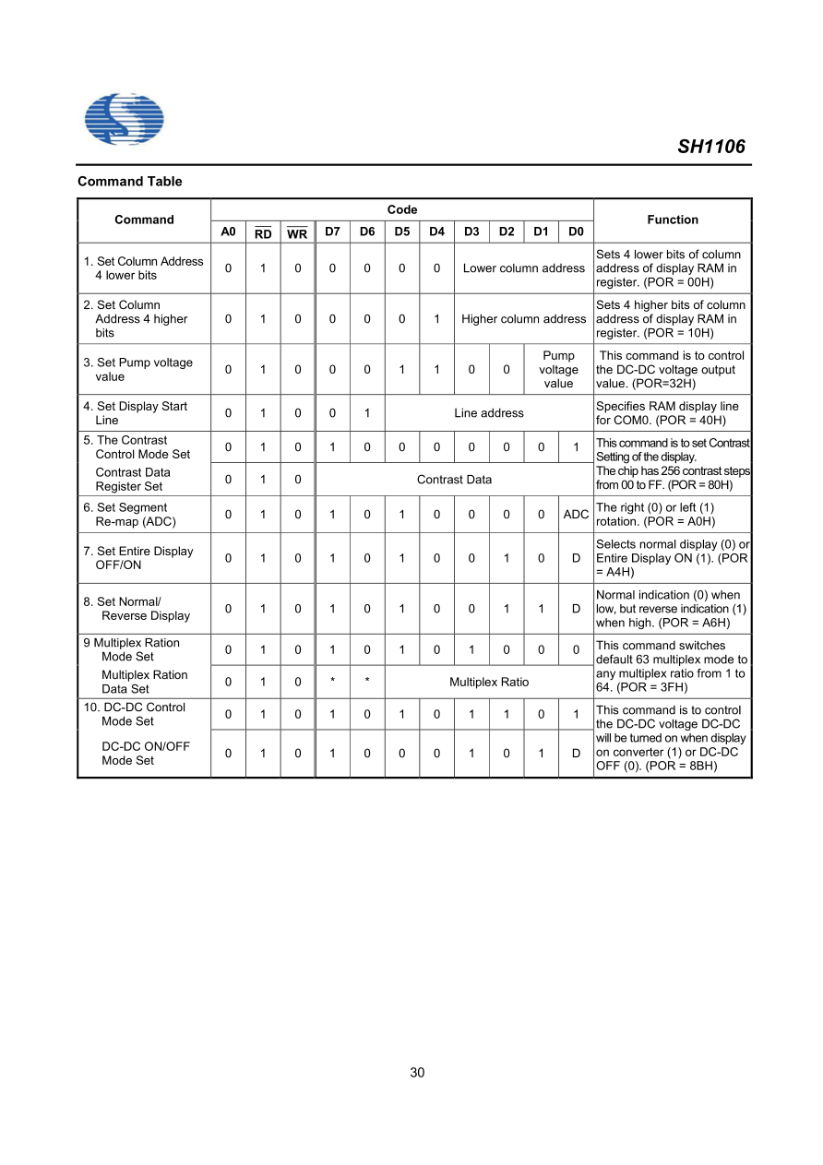
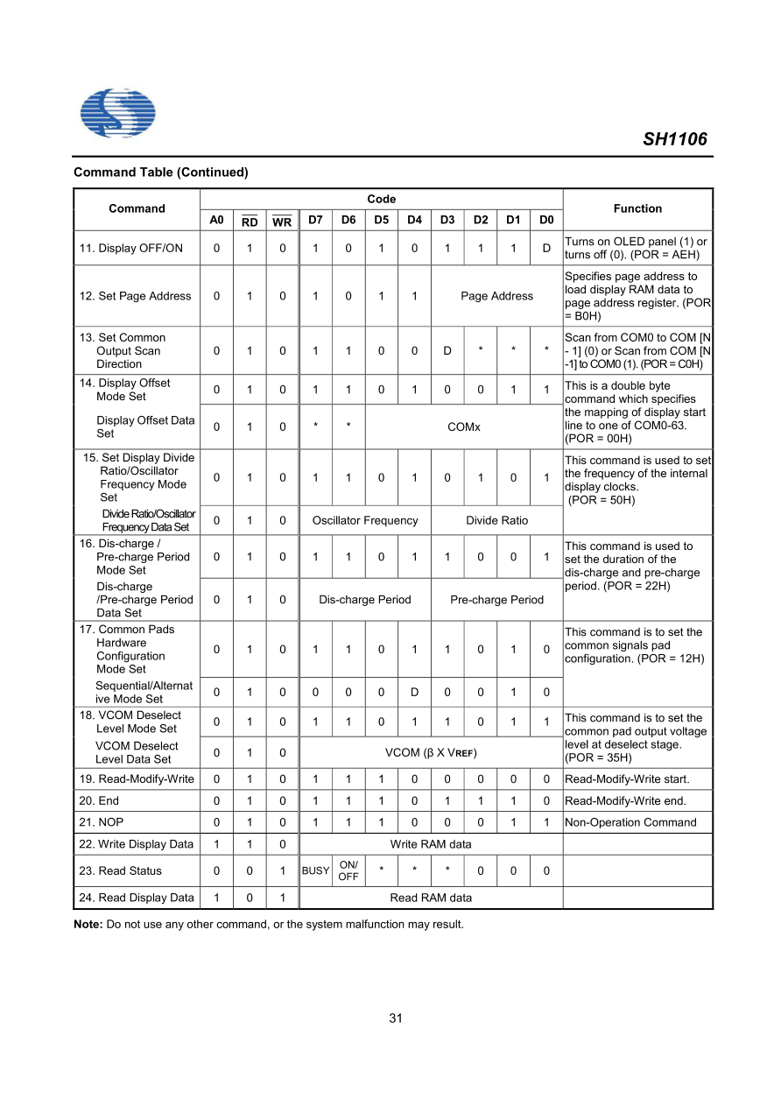
Command List

Slide 8
Writing Display Data
Set Page
Set Column
Stream Data Bytes
Column Auto-Increments

Slide 9
Framebuffer-Based Rendering
Local Buffer in MCU
Modify pixels in RAM
Push to display periodically
Notes:
Instead of modifying the display directly, a framebuffer is maintained locally, simplifying drawing and improving performance

Slide 10
RMW vs Framebuffer
Read – Modify – Write
  Complex
  Requires reads + dummy cycles
Frambuffer
  Faster
  Simpler
  More flexible
Notes:
Although the display supports read-modify-write, a framebuffer approach is more efficient and easier to manage

Slide 11
Display Orientation
Segment remap -> horizontal flip
COM scan direction -> vertical flip
Notes:
These commands allow the display to be mounted in any orientation without changing software logic

Slide 12
Display Behvaior Commands
Contrast (0x81)
Normal / Inverse Display
Entire display ON
Display ON/OFF
Notes:
These commands control how the display appears without changing pixel data

Slide 13
Display Positioning
Display start line -> Scrolling
Display offset -> vertical shift
Notes:
These allow vertical shifting and scrolling effects without modifying memory

Slide 14
Hardware Config. (Initialization Parameters)
Multiplex ratio
Clock frequency
Pre-charge timing
COM configuration
VCOM level
Notes:
These parameters configure how the display is physically driven and are set once during initialization

Slide 15
Display Timing Insight (Multiplexed Scanning)
Rows scanned sequentially
Drivers apply column data
Refresh creates image
Notes:
The display is not static – it is continuously scanned to maintain the image.

Slide 16
Input Handling (ADC-based Control)
Two pots. -> x/y
High sampling rate
Position mapped to pixels
Notes:
Analog inputs are sampled continuously and mapped to display coordinates

Slide 17
Smooth Drawing (preventing skipped pixels)
Track previous position
Draw line between points
Notes:
Drawing lines between samples prevents gaps when the input changes quickly

Slide 18
Future Work (extensions and features)
Snake game
Conway’s game of Life editor
Menu System
PCB + enclosure
Notes:
This system can be extended into a full embedded gaming platform

Slide 19
Conclusion (Key takeaways)
Full display driver implemented
Framebuffer architecture
Depp understanding of display hardware
Expandable system design
Notes:
This project demonstrates low-level display control an provides a foundation for more advanced embedded graphics systems

Slide 20
Display Addressing commands
1 Set lower column address
2 Set Upper column address

Slide 21
Display Control Commands
3 not important. Controls internal circuitrty
4 Set display Start line
5 Set contrast control register

Slide 22
Display Transform Commands
6 Set segment remap – flips diplay horizontally
7 Set entire display on/off
8 Set normal/reverse display – inverts bits of display

Slide 23
Hardware config commands
9 set multiplex ration
10 set DC-DC off/on

Slide 24
Chandy’s Suggestions
Watch the clock. 5 minute limit
Whats interesting about the new device?
What challenges did you encounter?

